Slide 1
CE 5351: Advanced Math for Civil Engineers Implementation of the Analytic Element Method to Describe the Flow Around Impermeable Cylinders
Presentation by Kathleen Thurmes

Slide 2
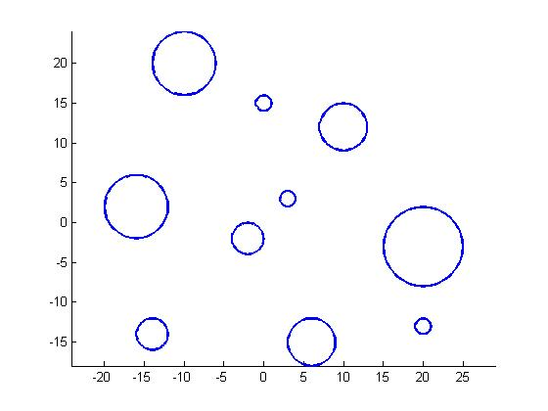
Cylinder Configuration

Slide 3
Methods
Complex variable method outlined in Dr. Otto D.L. Strack’s Applied Groundwater Mechanics
Analytic element method with a numerical integration of Cauchy integrals as described in Dr. Otto D.L. Strack’s Vector Analysis

Slide 4

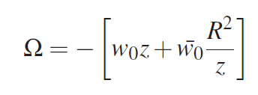
The Complex Potential
Notes:
Omega is a function of z. The real part of this complex potential is phi, which plots the equipotentials. The imaginary part of the function is psi and it represents the streamlines of the function. Throughout this presentation, I’ll be plotting only the imaginary part of this equation.

Slide 5
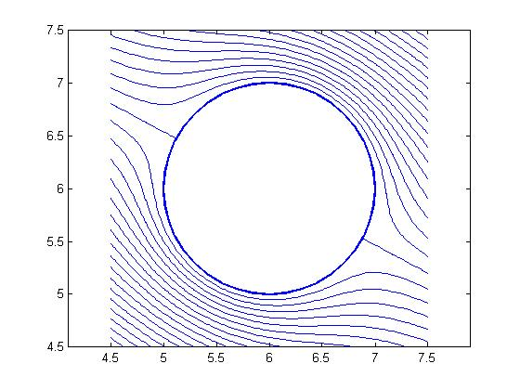
A Single Cylinder in a Field of Uniform Flow

Slide 6
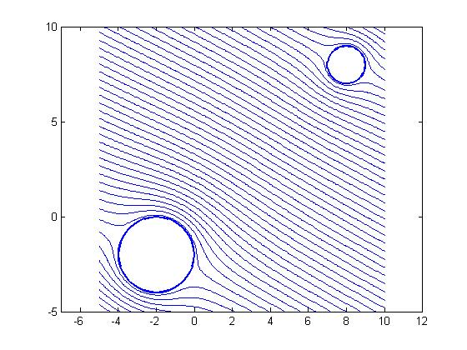
Two Cylinders in a Field of Uniform Flow

Slide 7
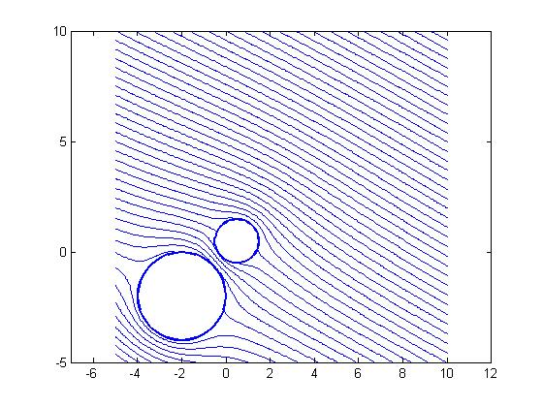
Bring Them Close Together…

Slide 8


Approximating a Solution
A single cylinder

Slide 9
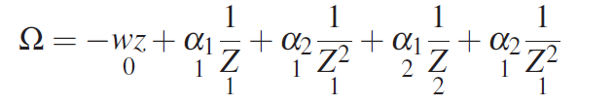
Approximating a Solution
A single cylinder
Two cylinders

Slide 10
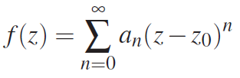
Finding $α$ Values
A function that is holomorphic inside the radius R:

Slide 11
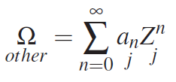
Finding $α$ Values
A function that is holomorphic inside the radius R:
Taylor series expansion for many cylinders:
Notes:
But how do we find the a’s?

Slide 12

Finding $α$ Values
The Cauchy integral:

Slide 13
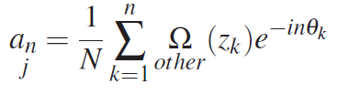
Finding $α$ Values
The Cauchy integral:
Numerical integration of a Couchy integral:
Notes:
IT’S THE AVERAGE!

Slide 14
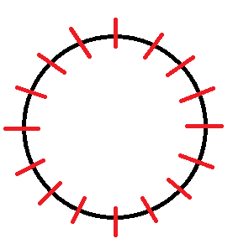



Finding $α$ Values
The Cauchy integral:
Numerical integration of a Couchy integral:
$$δ_{2}$$
$$δ_{1}$$
$$δ_{k}$$

Slide 15
Finding $α$ Values
Pseudocode:
Find_Alphas( Old_Alphas, Rs, v0s, Other_Function, Tolerance, Iteration)
-Initialize a count of changes
-For each cylinder:
-Find new alphas (using Couchy integral)
-Check if any of the new alphas differ from old by more than the tolerance. If so, add to count
-Increment Iteration variable
-If the count of changes > 0
-Check if maximum iterations have been reached
-If not, call Find_Alphas with new alphas and incremented Iteration variable

Slide 16
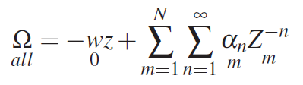
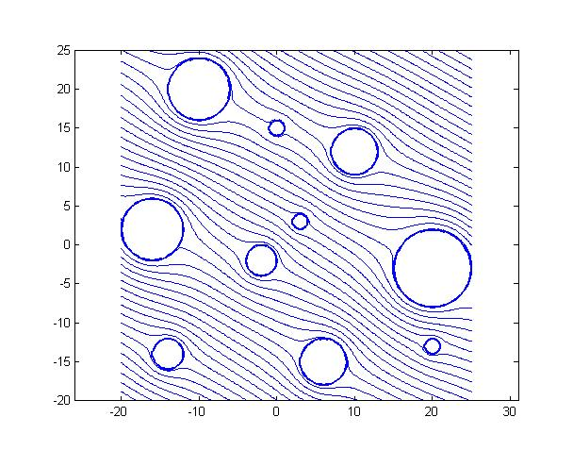

Using $α$ Values

Slide 17
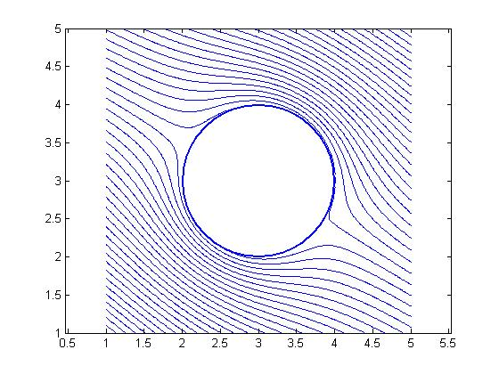
Using $α$ Values

Slide 18
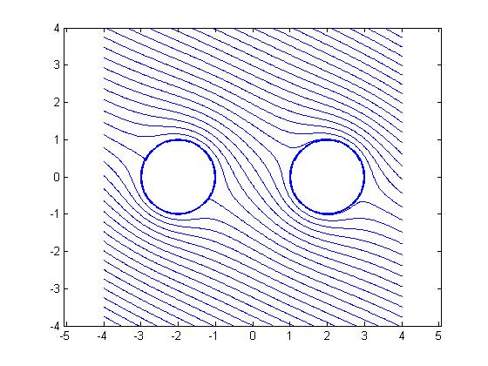
Limitations

Slide 19
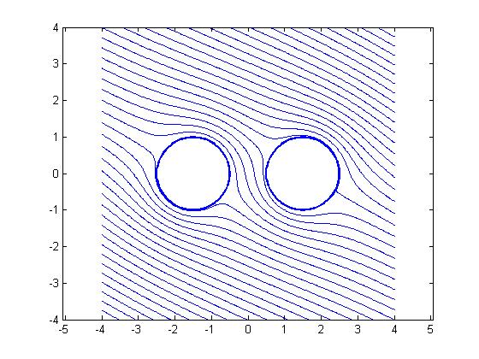
Limitations

Slide 20
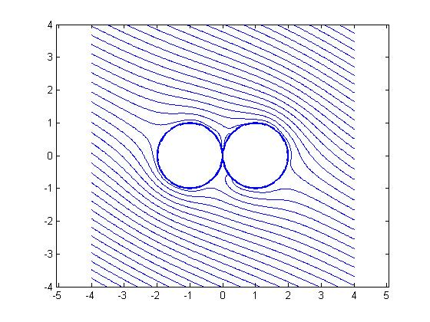
Limitations

Slide 21

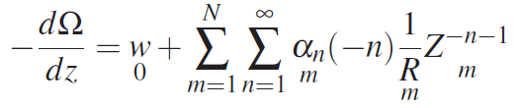
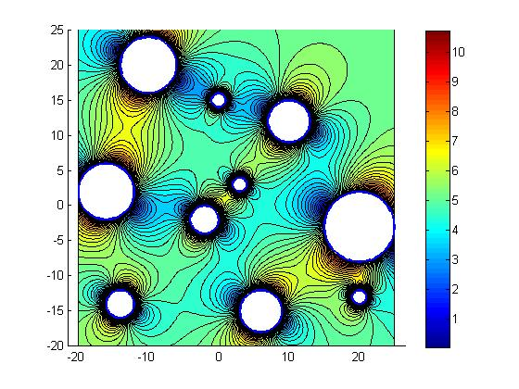
The Velocity

Slide 22
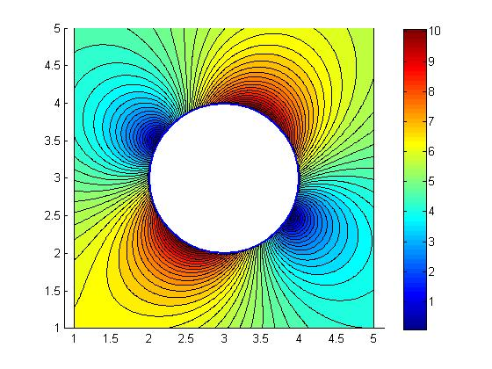
The Velocity
Notes:
Note there is some influence down at the bottom left. Note that the influence in the direction of flow is greater than tangent to it. Foresight & traffic.

Slide 23

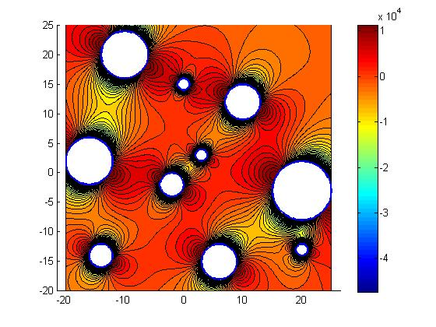
The Pressure

Slide 24
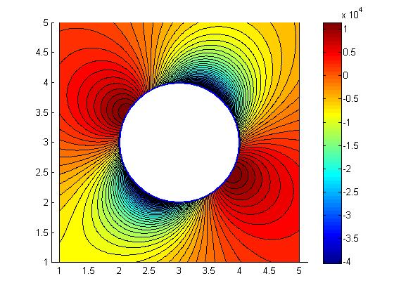
The Pressure

Slide 25
Thank You

Slide 26
Areas of Influence

